Slide 1
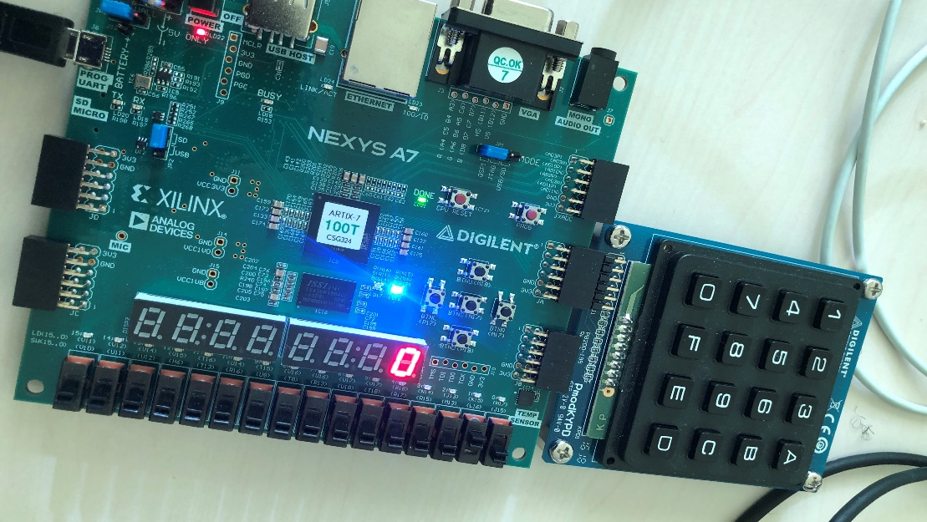
Password Alarm System
Kuye Doluwamu
Ajay Paul
Ashraf Siddiqi Mohammad

Slide 2
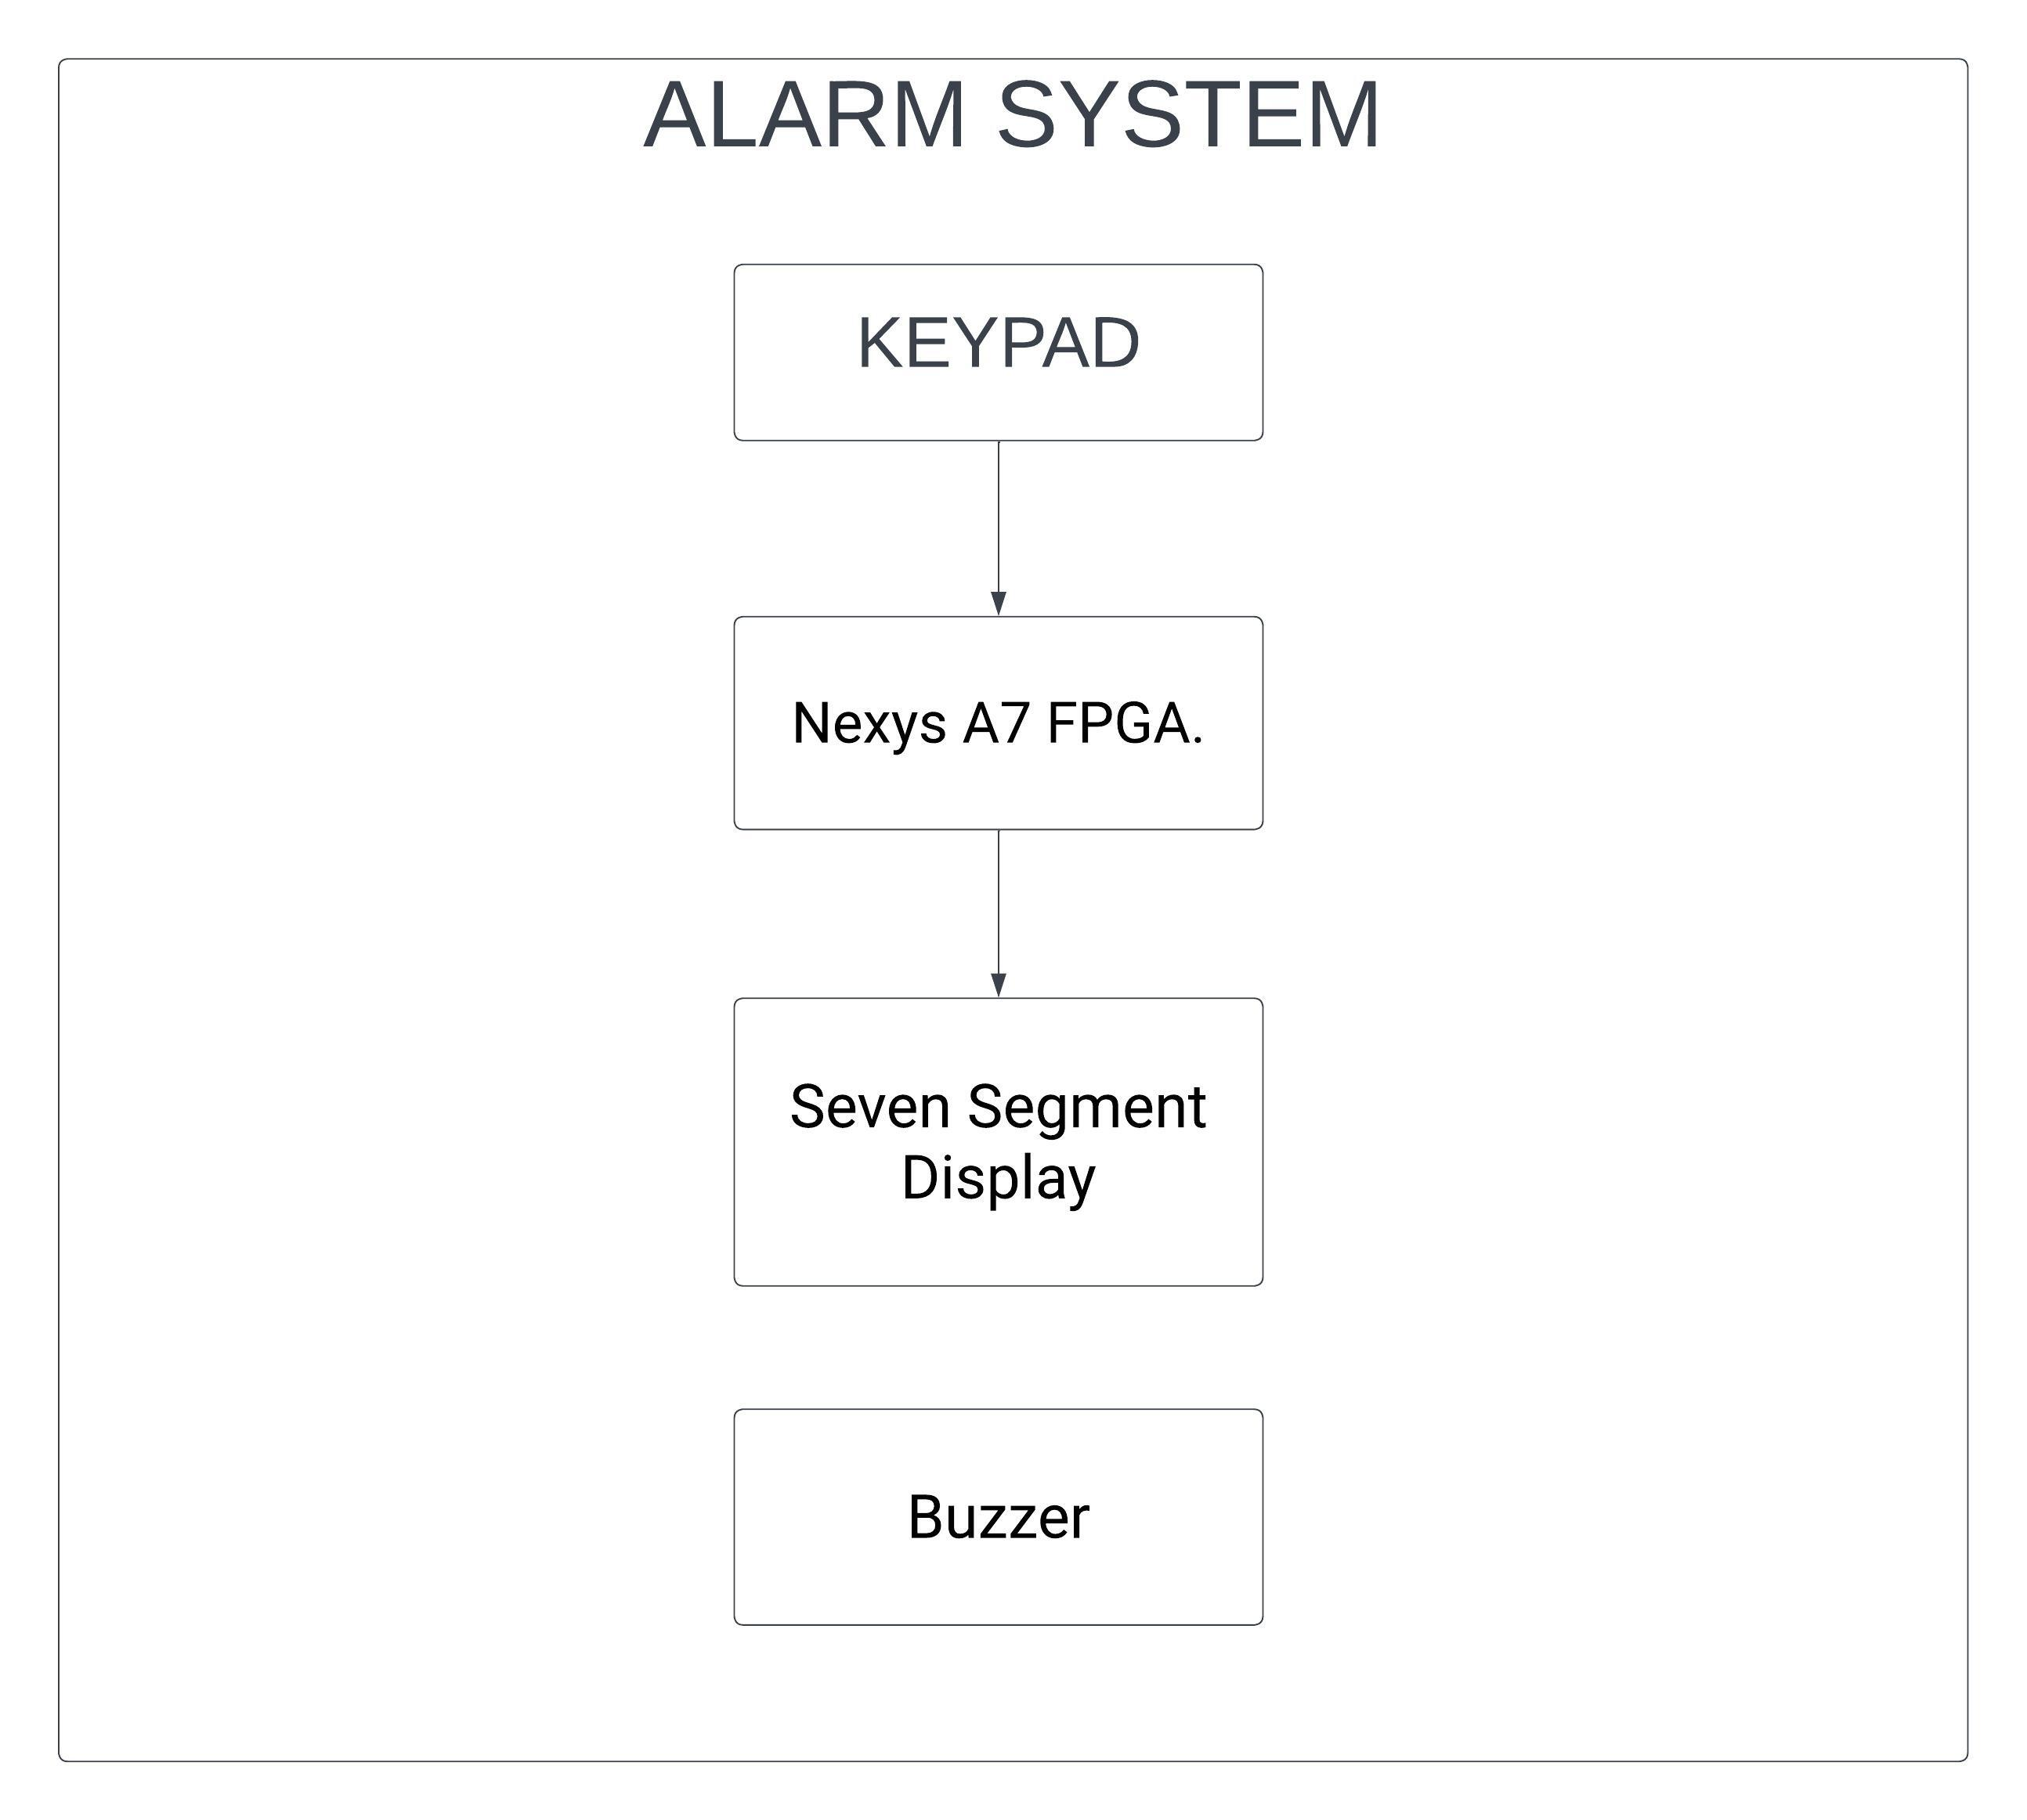
Block Diagram Of the System

Slide 3
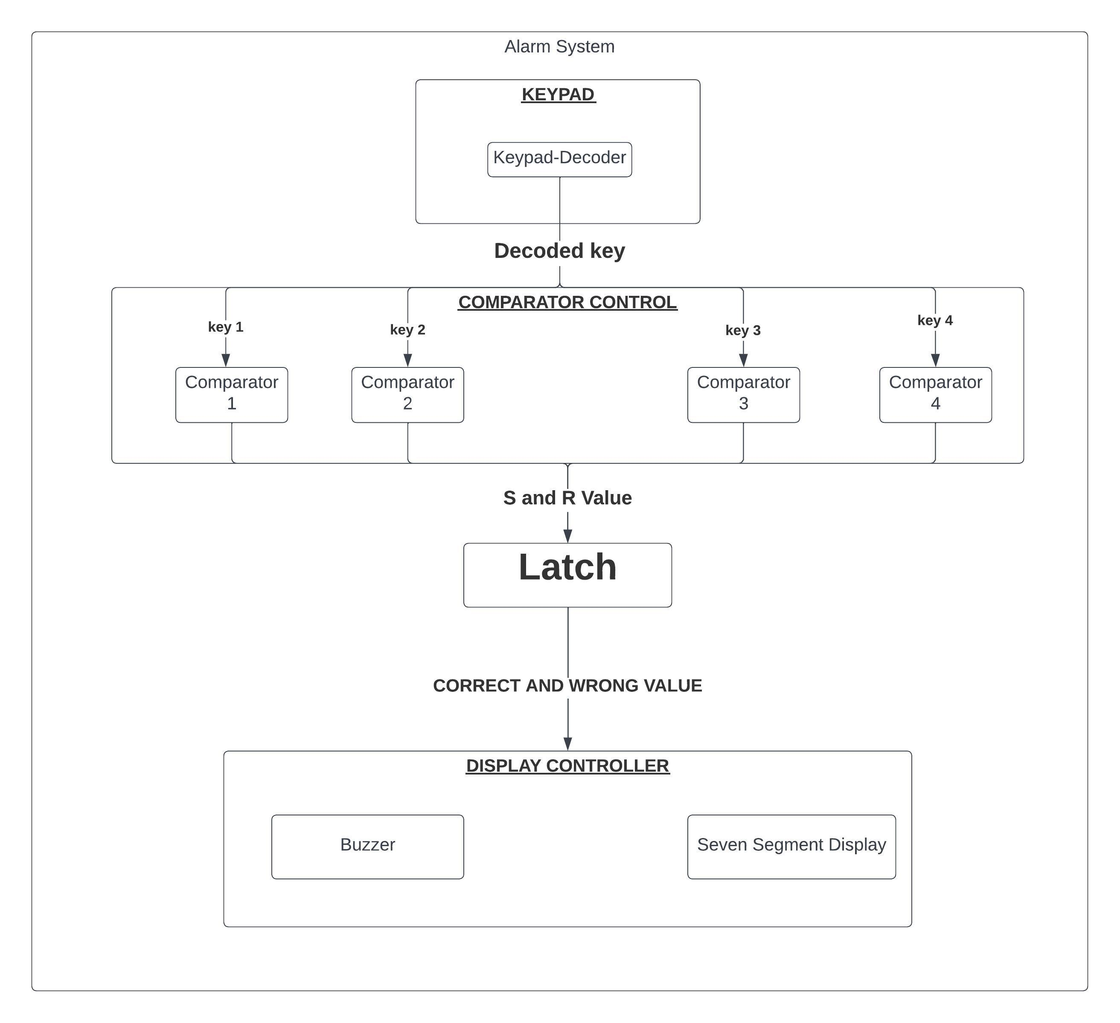
All System Modules

